Slide 1
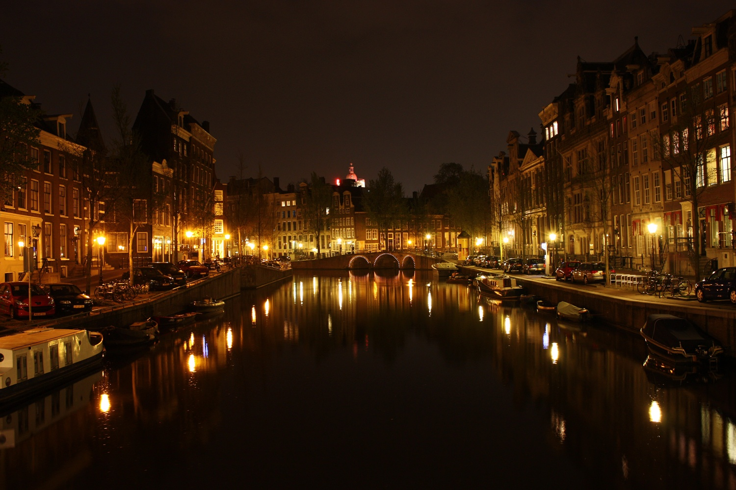
Automating Security with PowerShell
Jaap Brasser
@jaap_brasser

Slide 2
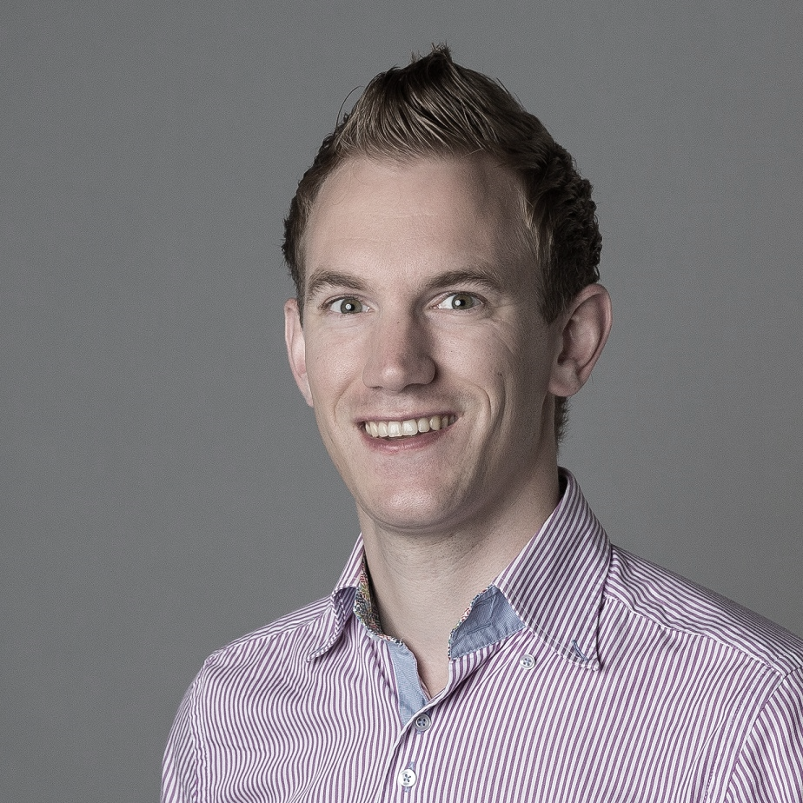
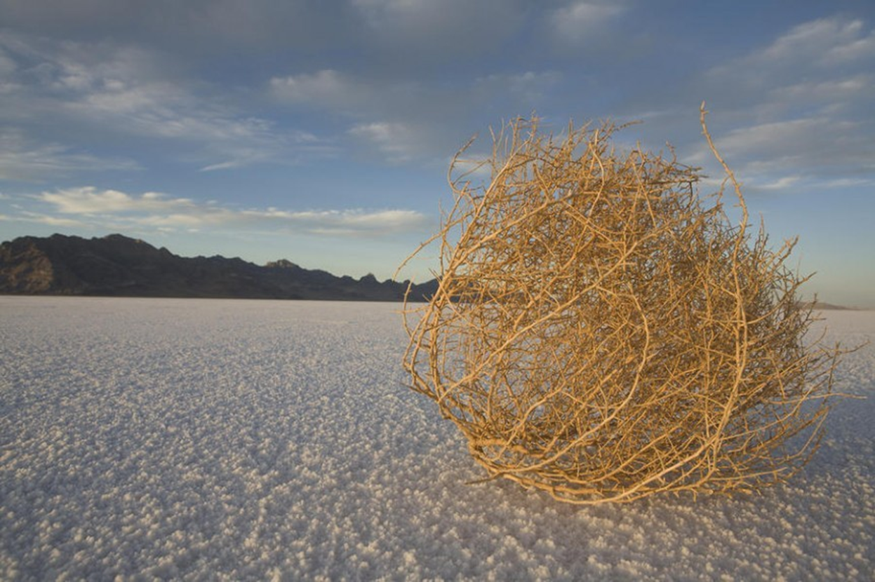

jaapbrasser.com/about
@Jaap_Brasser

Slide 3
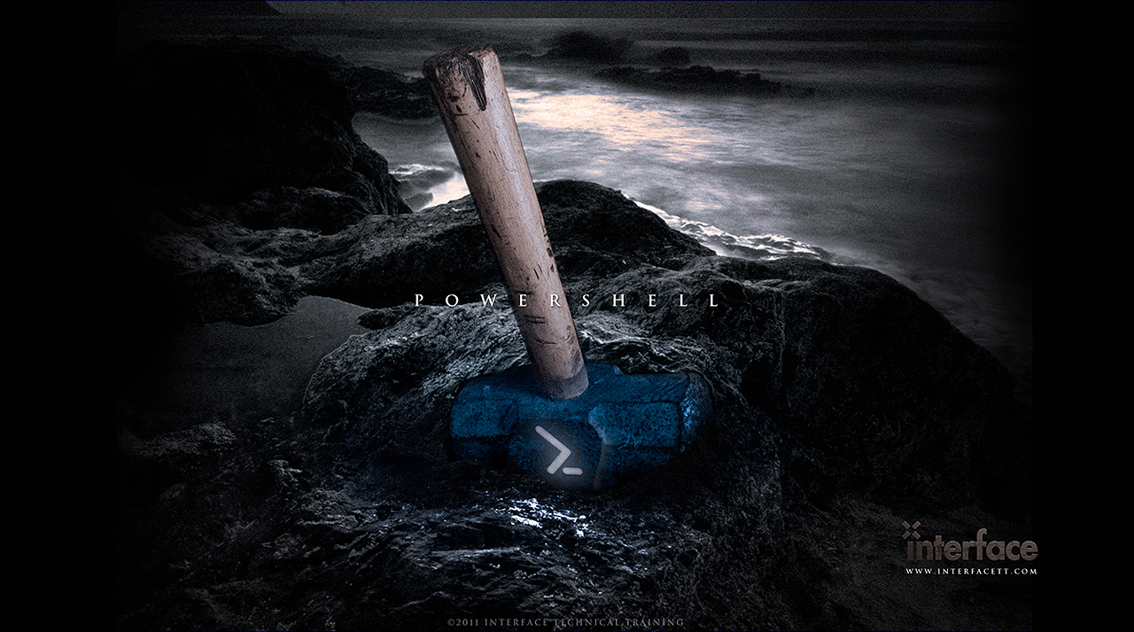
Agenda
PowerShell
& .\Demo
Defensive Offensive
& .\Demo
Ad-hoc
Q & A

Slide 4

Agenda
State of PowerShell

Slide 5

Agenda
Differences between editors
Configure VSCode
Working with Vscode
Setting up the ISE
Working with the ISE and ISESteroids
Questions
Demo
Mimikatz & PowerShell Logging

Slide 6
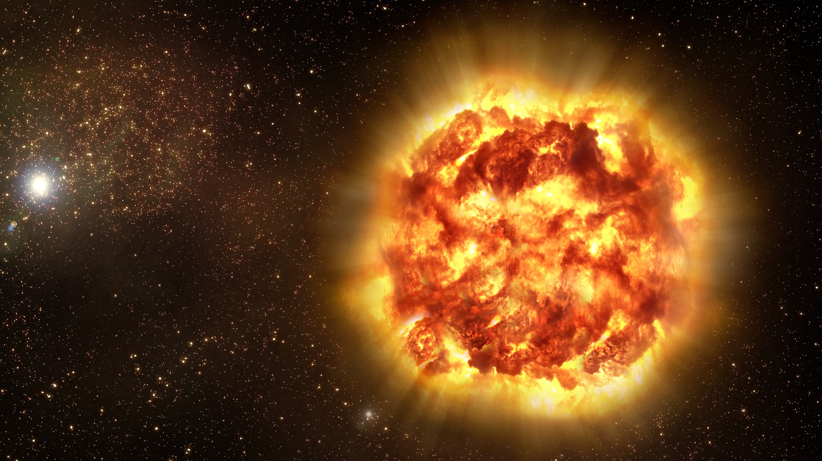
Demo Summary
Setup PowerShell logging
Dump credentials
Reconfigure logging
Follow bread crumbs
Determined what ran

Slide 7
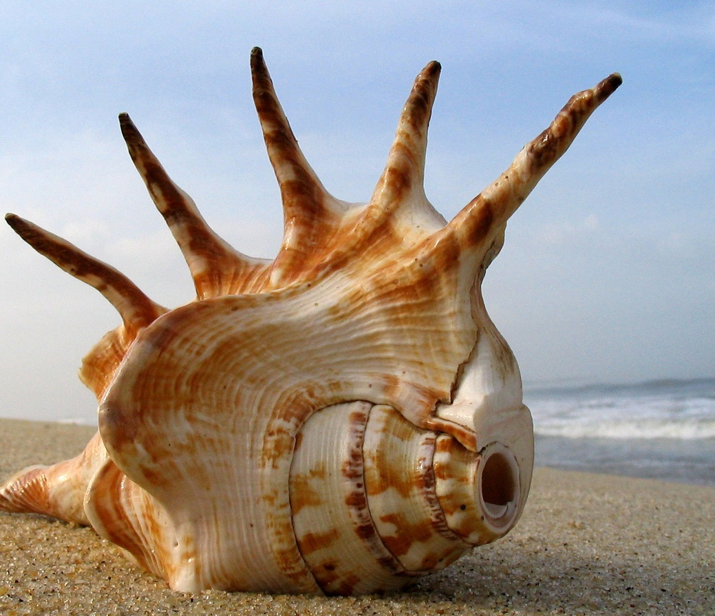
Agenda
Offensive PowerShell

Slide 8
Agenda
Differences between editors
Configure VSCode
Working with Vscode
Setting up the ISE
Working with the ISE and ISESteroids
Questions
Demo
Obfuscation & Detection

Slide 9
Demo Summary
Determined character frequency
Used Vector Frequency
Encoded existing scripts
Looked at different methods of obfuscation

Slide 10

Agenda
Defensive PowerShell

Slide 11
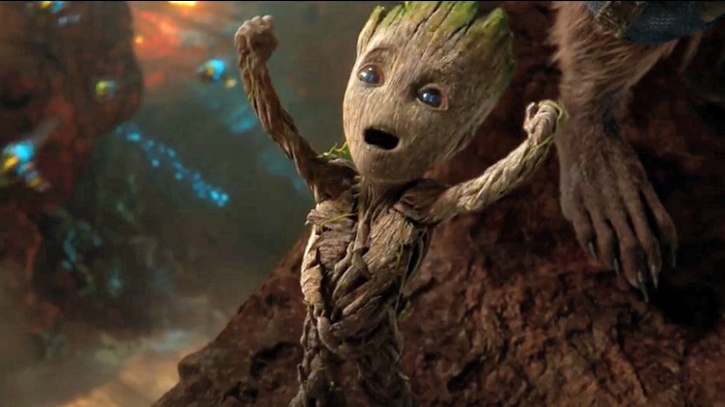
Questions

Slide 12
References
github.com/jaapbrasser/Events/tree/master/BSidesAms2017
www.bsidesams.nl
jaapbrasser.com

